Slide 1
MOVEMENTS OF LARGE INTESTINE
By
Dr. Mahadevi A.L
Dept of Physiology
SKHMC

Slide 5
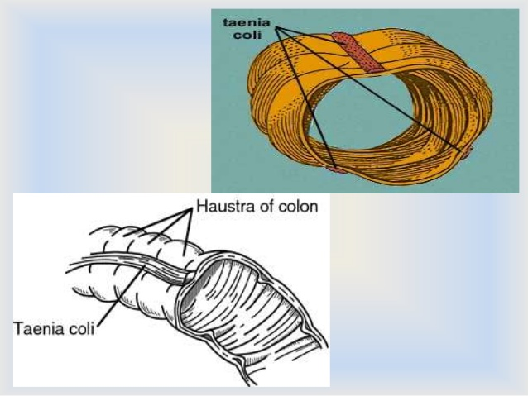

Slide 6
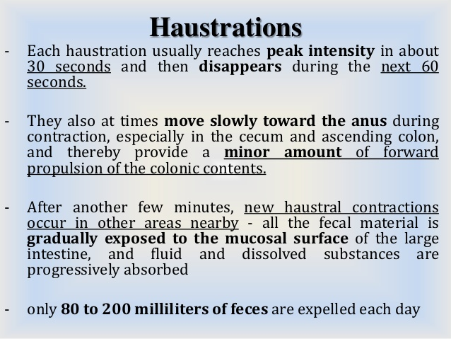

Slide 7
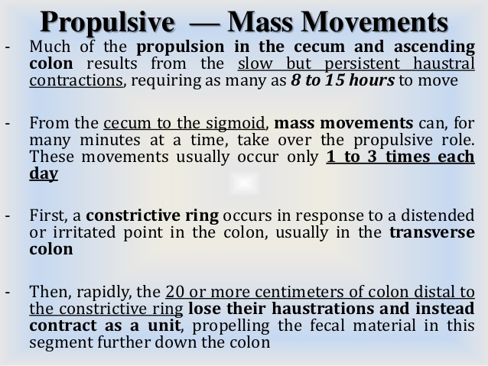

Slide 8
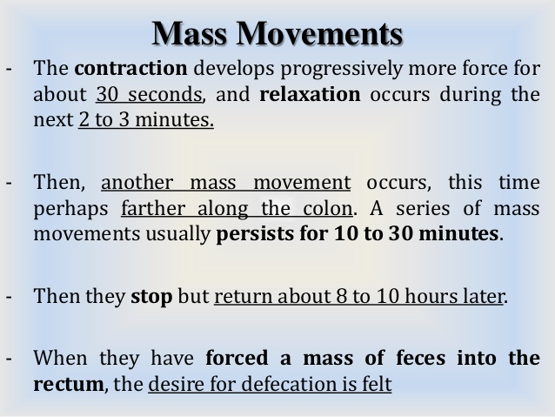

Slide 12
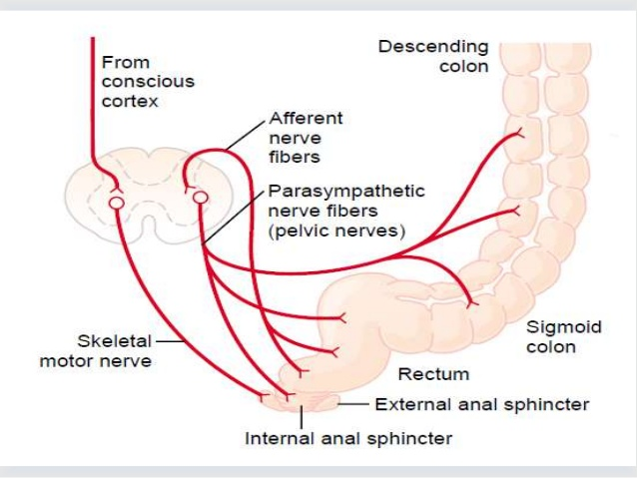

Slide 15
Thank u

